Slide 1
ApeRobot
Documentation

Slide 2
The Hardware

Slide 3
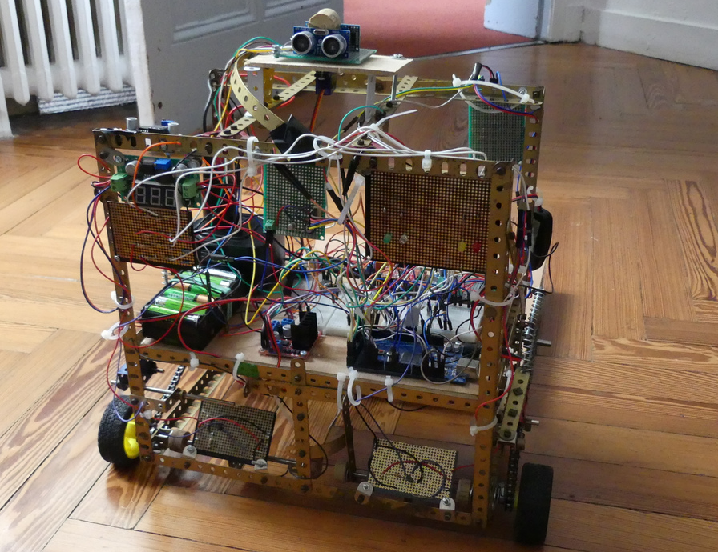
HarDware
ApeRobot Documentation

Slide 4
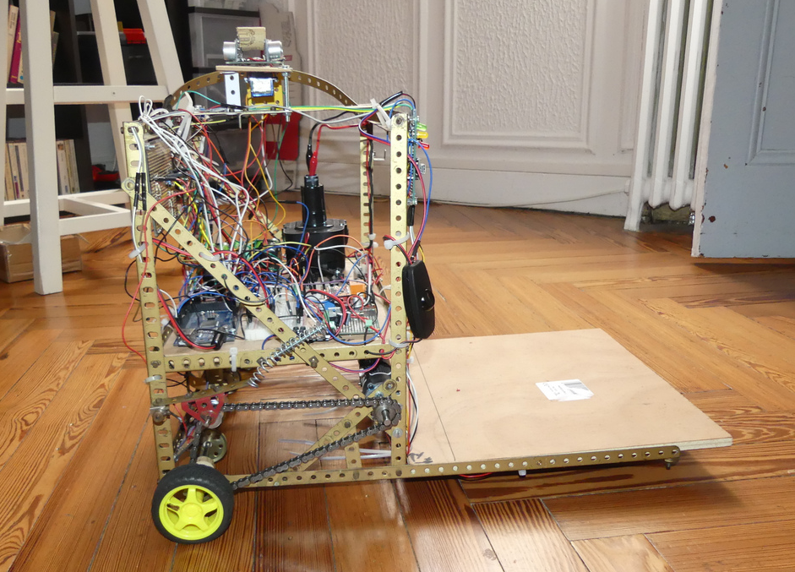
Echo system
Electronic
Moving system

Slide 5
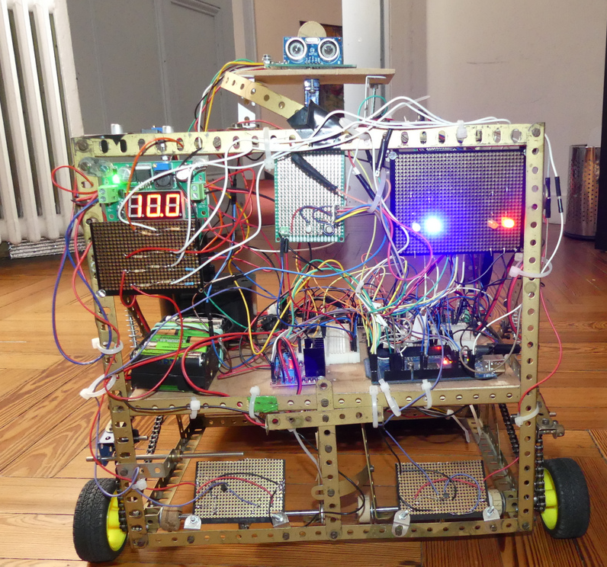
Encoders power switch
Robot LED
Network LED
Motion LED
Motors Voltage Regulator
Electronic Power LED
Voltage dividers
Motors controler
Wheel control system

Slide 6
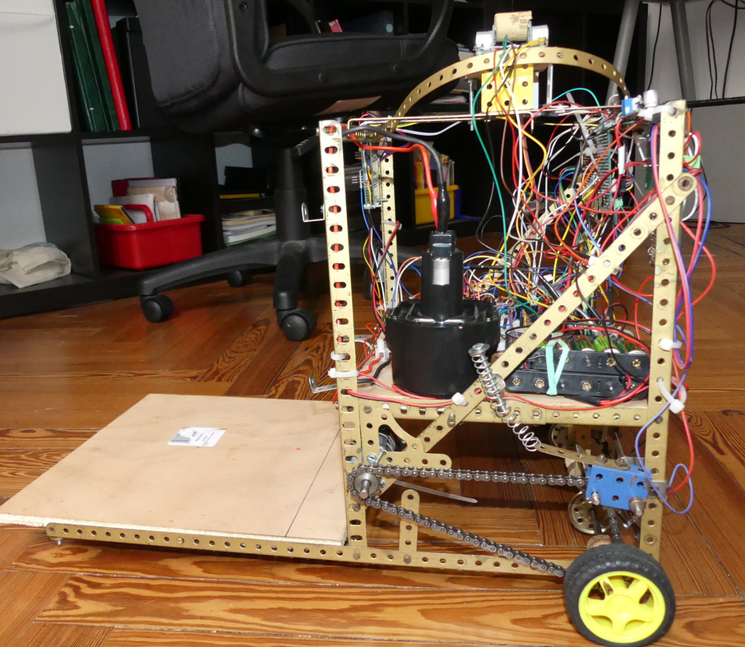
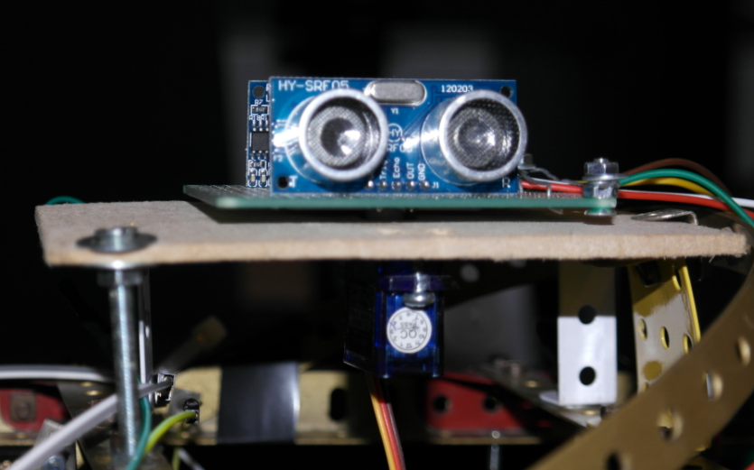
Servo-motor
Echo system
Electronic Battery
Motors Battery
Left motor
Chain-adjuster

Slide 7
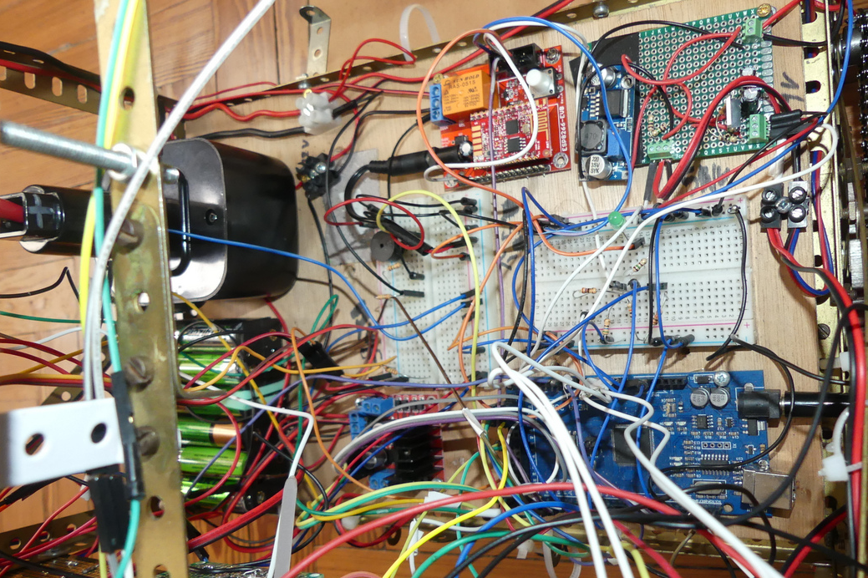
WIFI Gateway
9V Power regulator
Motors power relay
5V Power regulator
Arduino ATMega

Slide 8
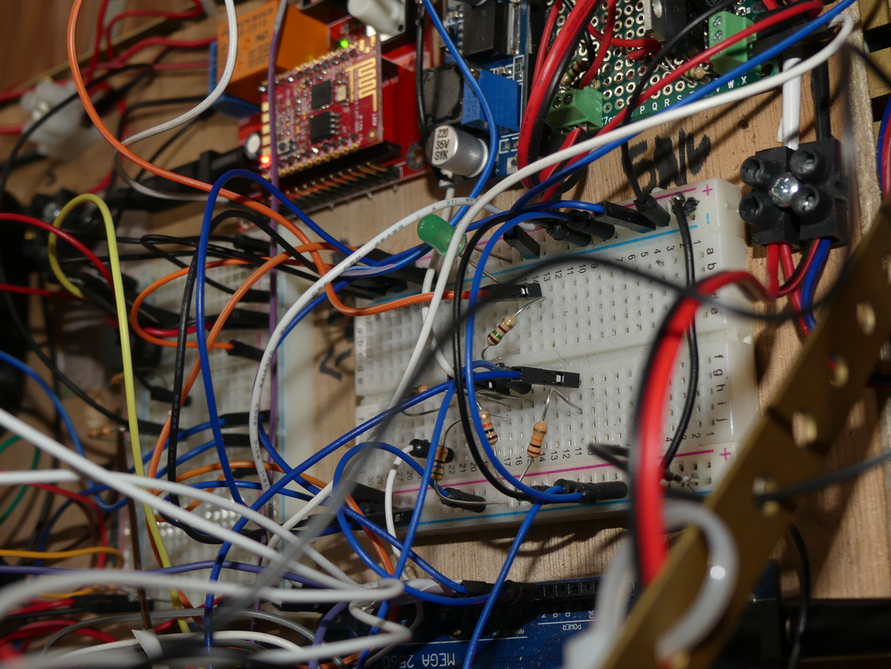
Motors power relay
5V Power regulator
WIFI Gateway
9V Power regulator
Arduino ATMega

Slide 9
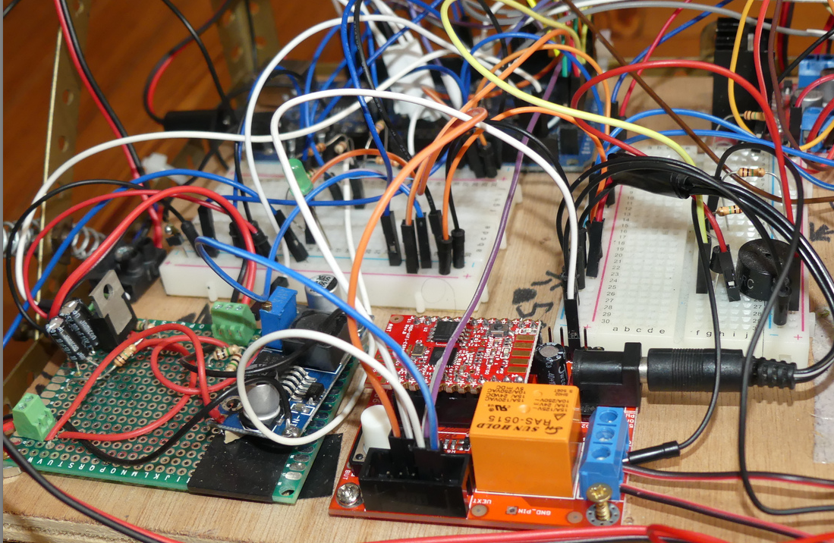
WIFI Trafic LED
WIFI LED wire
9v regulator
ESP8266
Network trace wire
Serial transmit wire
5v regulator
Ground wire
Serial receive wire

Slide 10
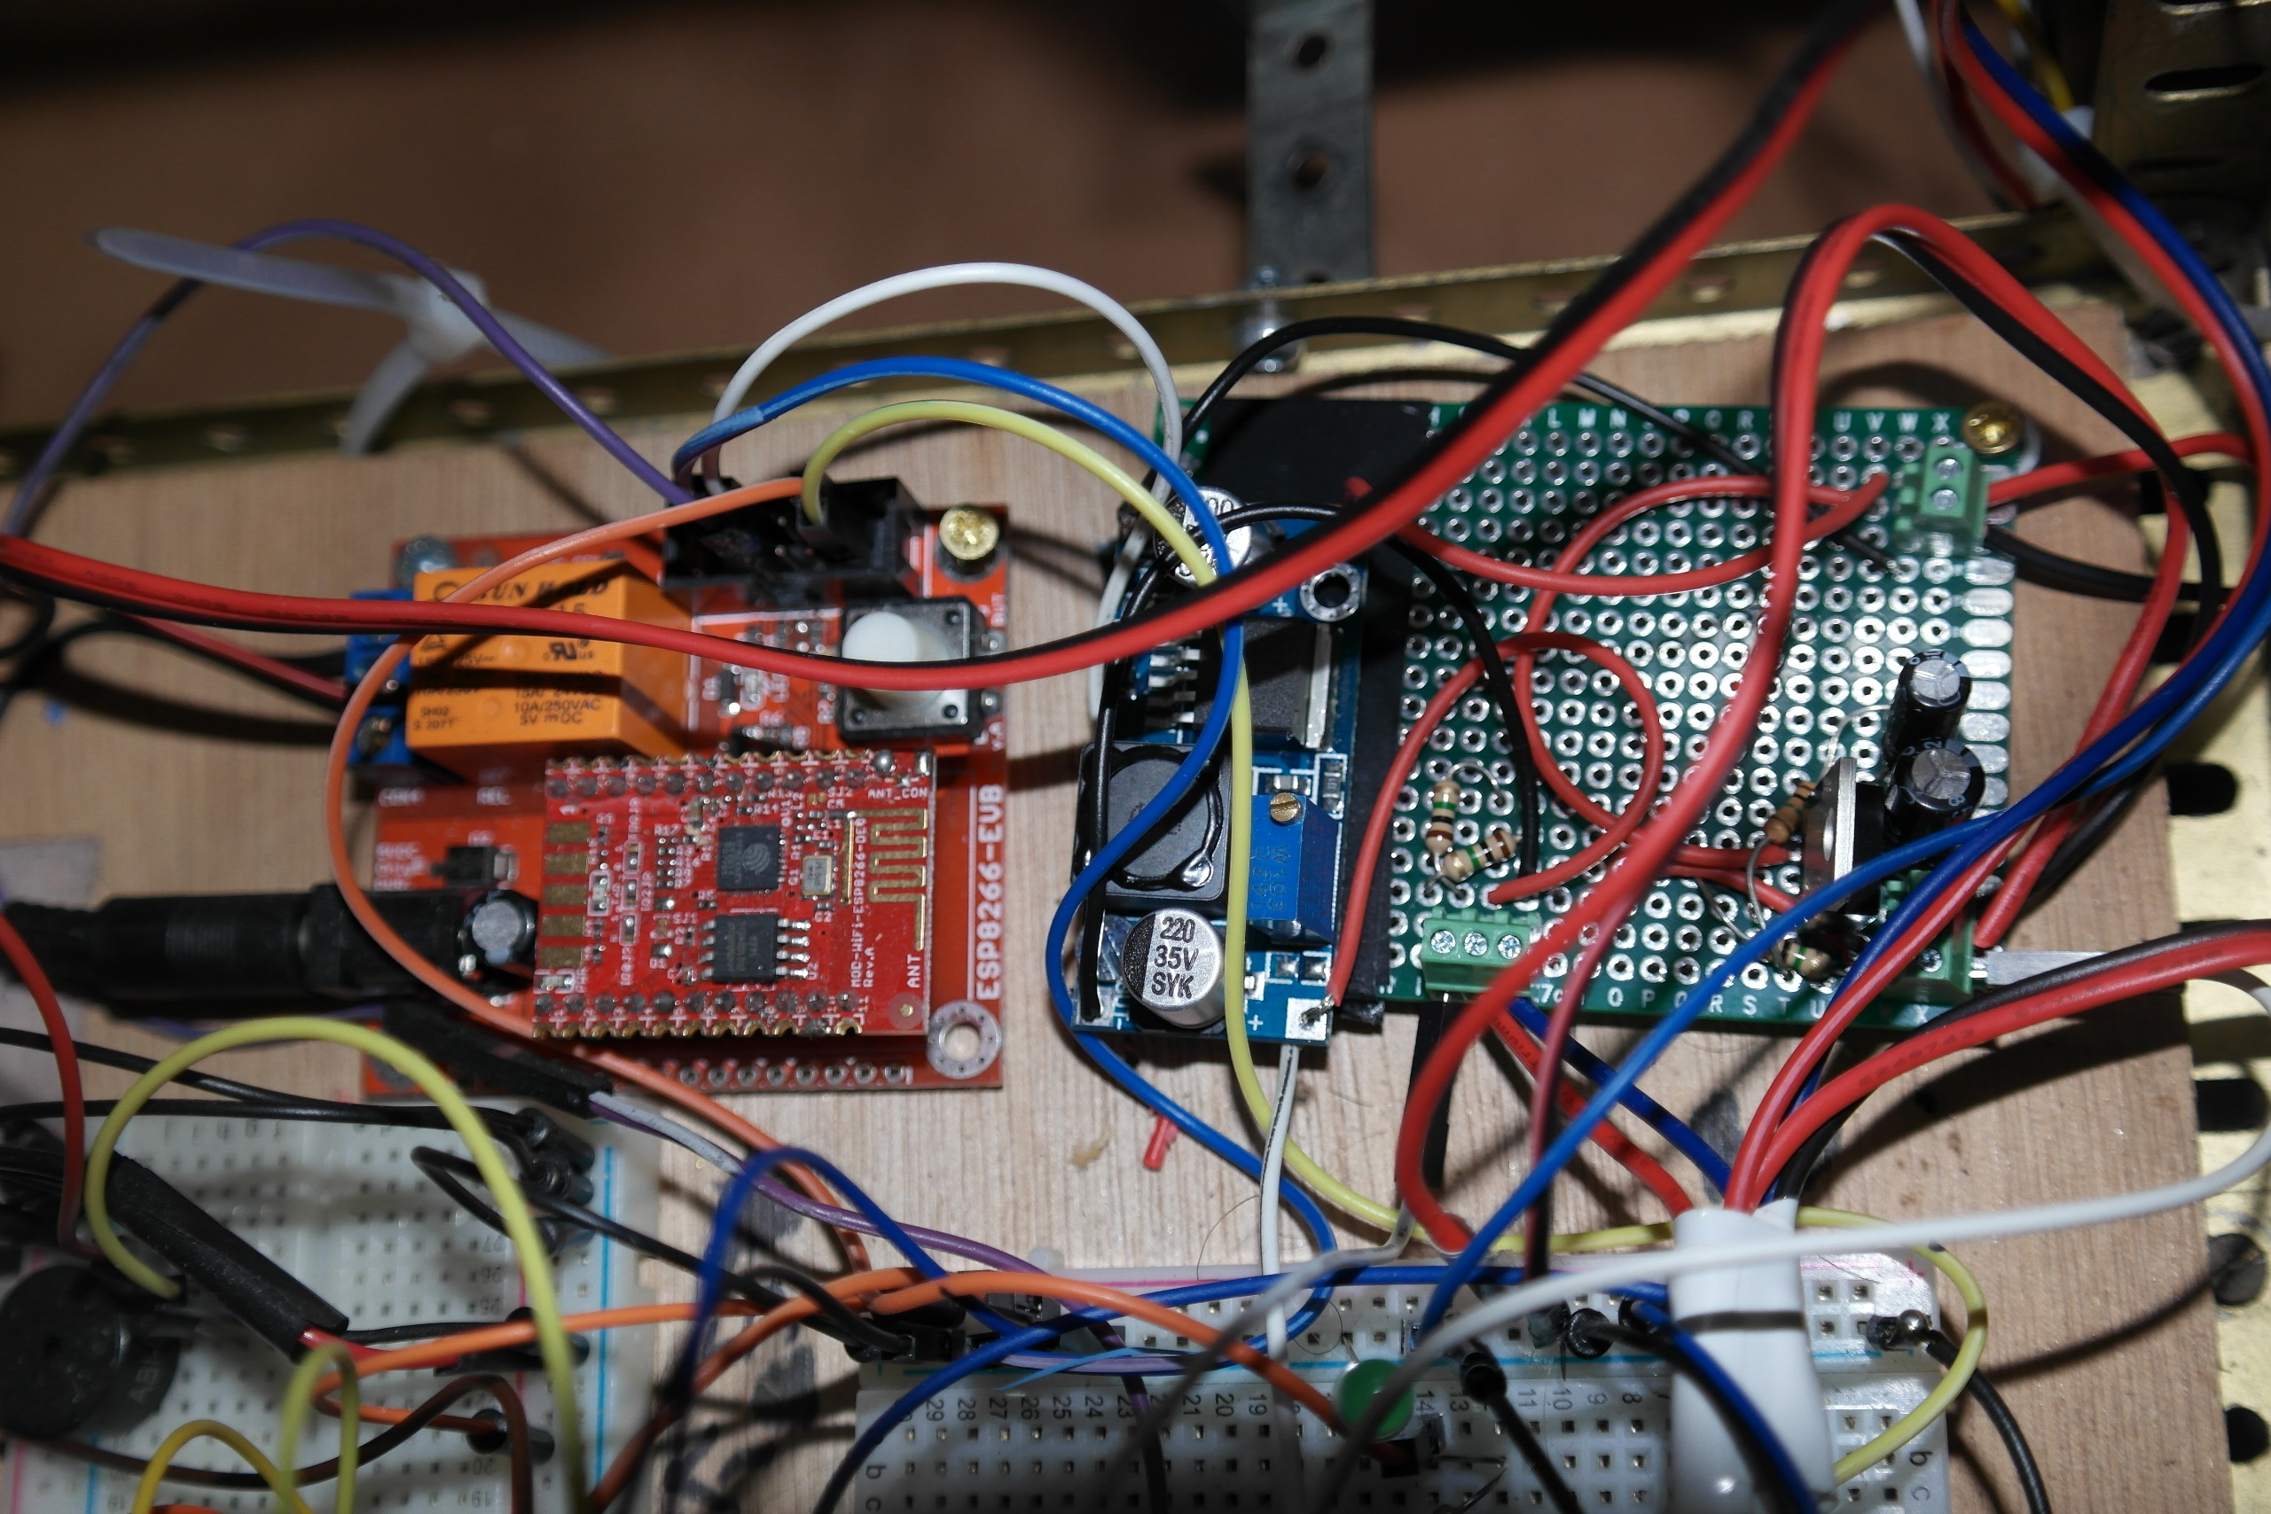
9v regulator
5v regulator
Serial receive wire
Serial transmit wire
ESP8266
WIFI LED wire
WIFI Gateway Instrutable
Ground wire
Network trace wire

Slide 11
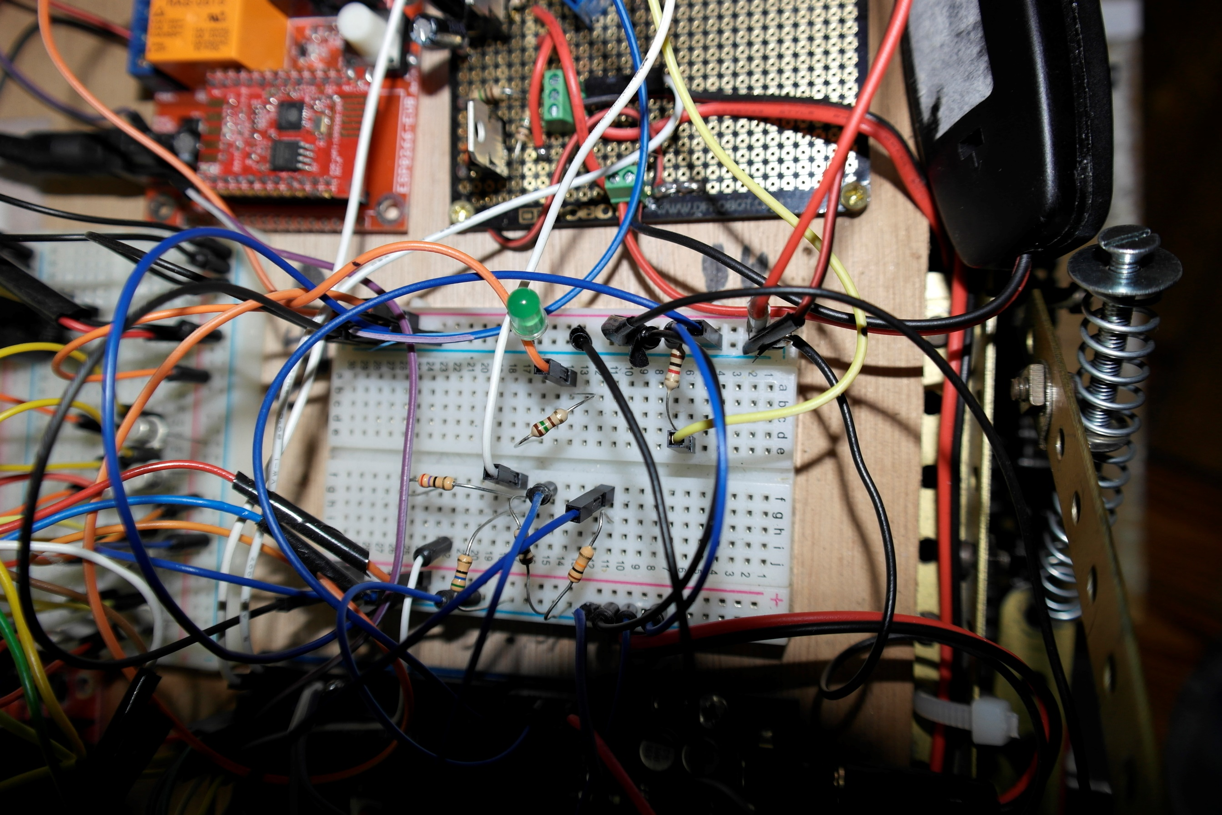
WIFI trafic LED
+5 volts
Arduino PIN 3
Arduino PIN 2
LED resistor
Pull down resistor
ESP8266 Serial RD
Unplug to get UDP trace
+5 volts
Voltage devider
ESP8266 Serial RD
Arduino Serial TD
Pull down resistor
10k
Pull down resistor

Slide 12
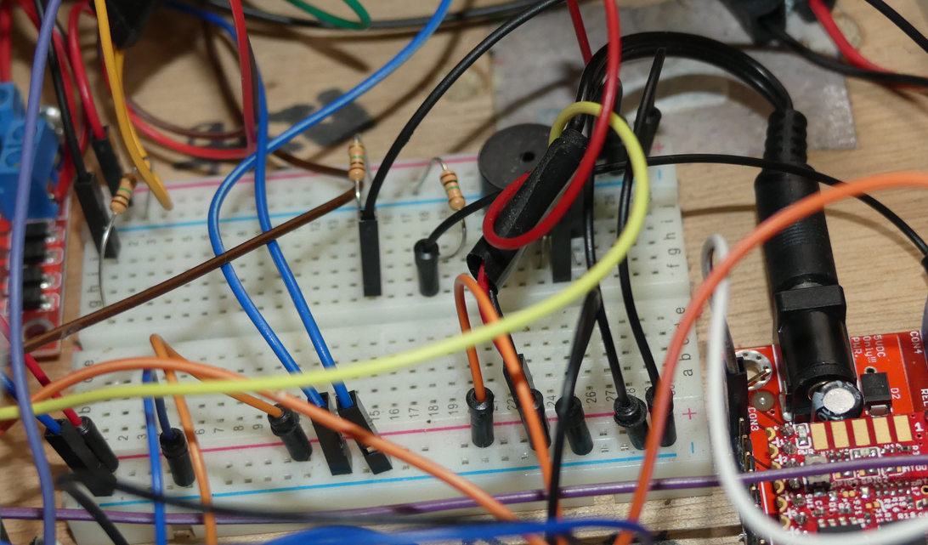
Buzzer
Arduino buzzer PIN
+12 volts (input regulator for motors)
Ground (motors batteries)
+12 volts (motors batteries)

Slide 13
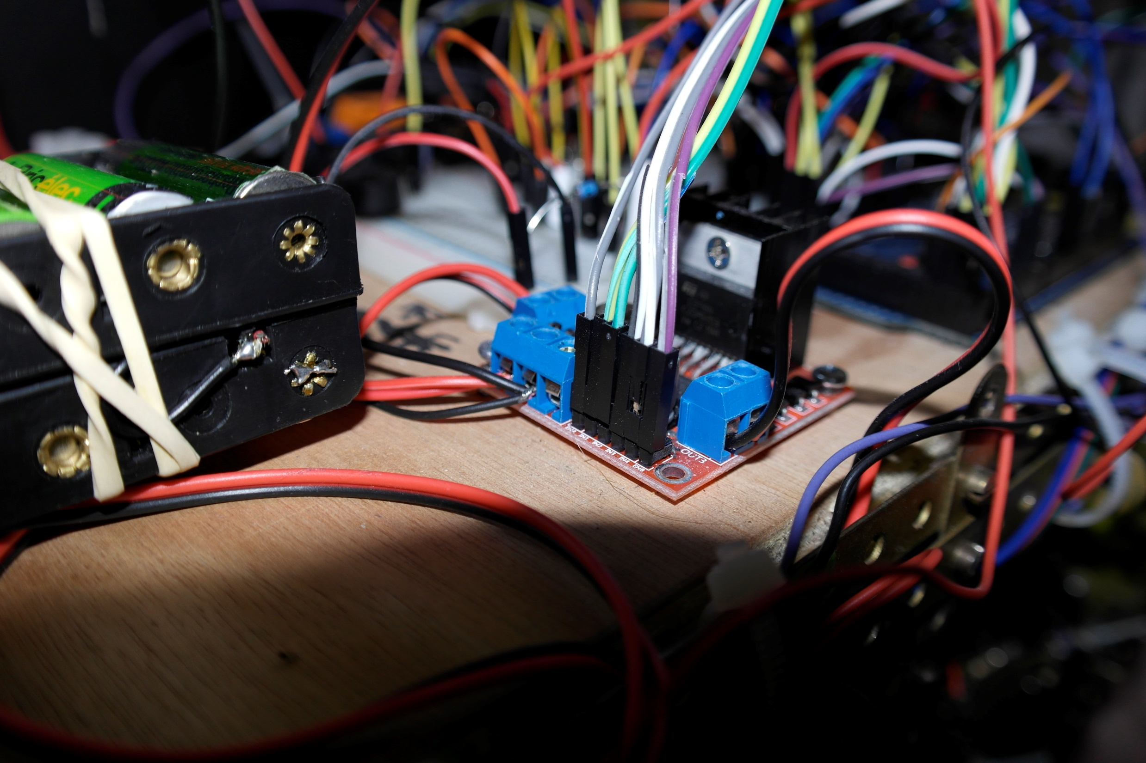
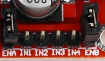
To Arduino Motors PIN
Right motor 12v power
+12v to breadboard
+12v from regulator
Ground
Motors Batteries
Left motor 12v power

Slide 14
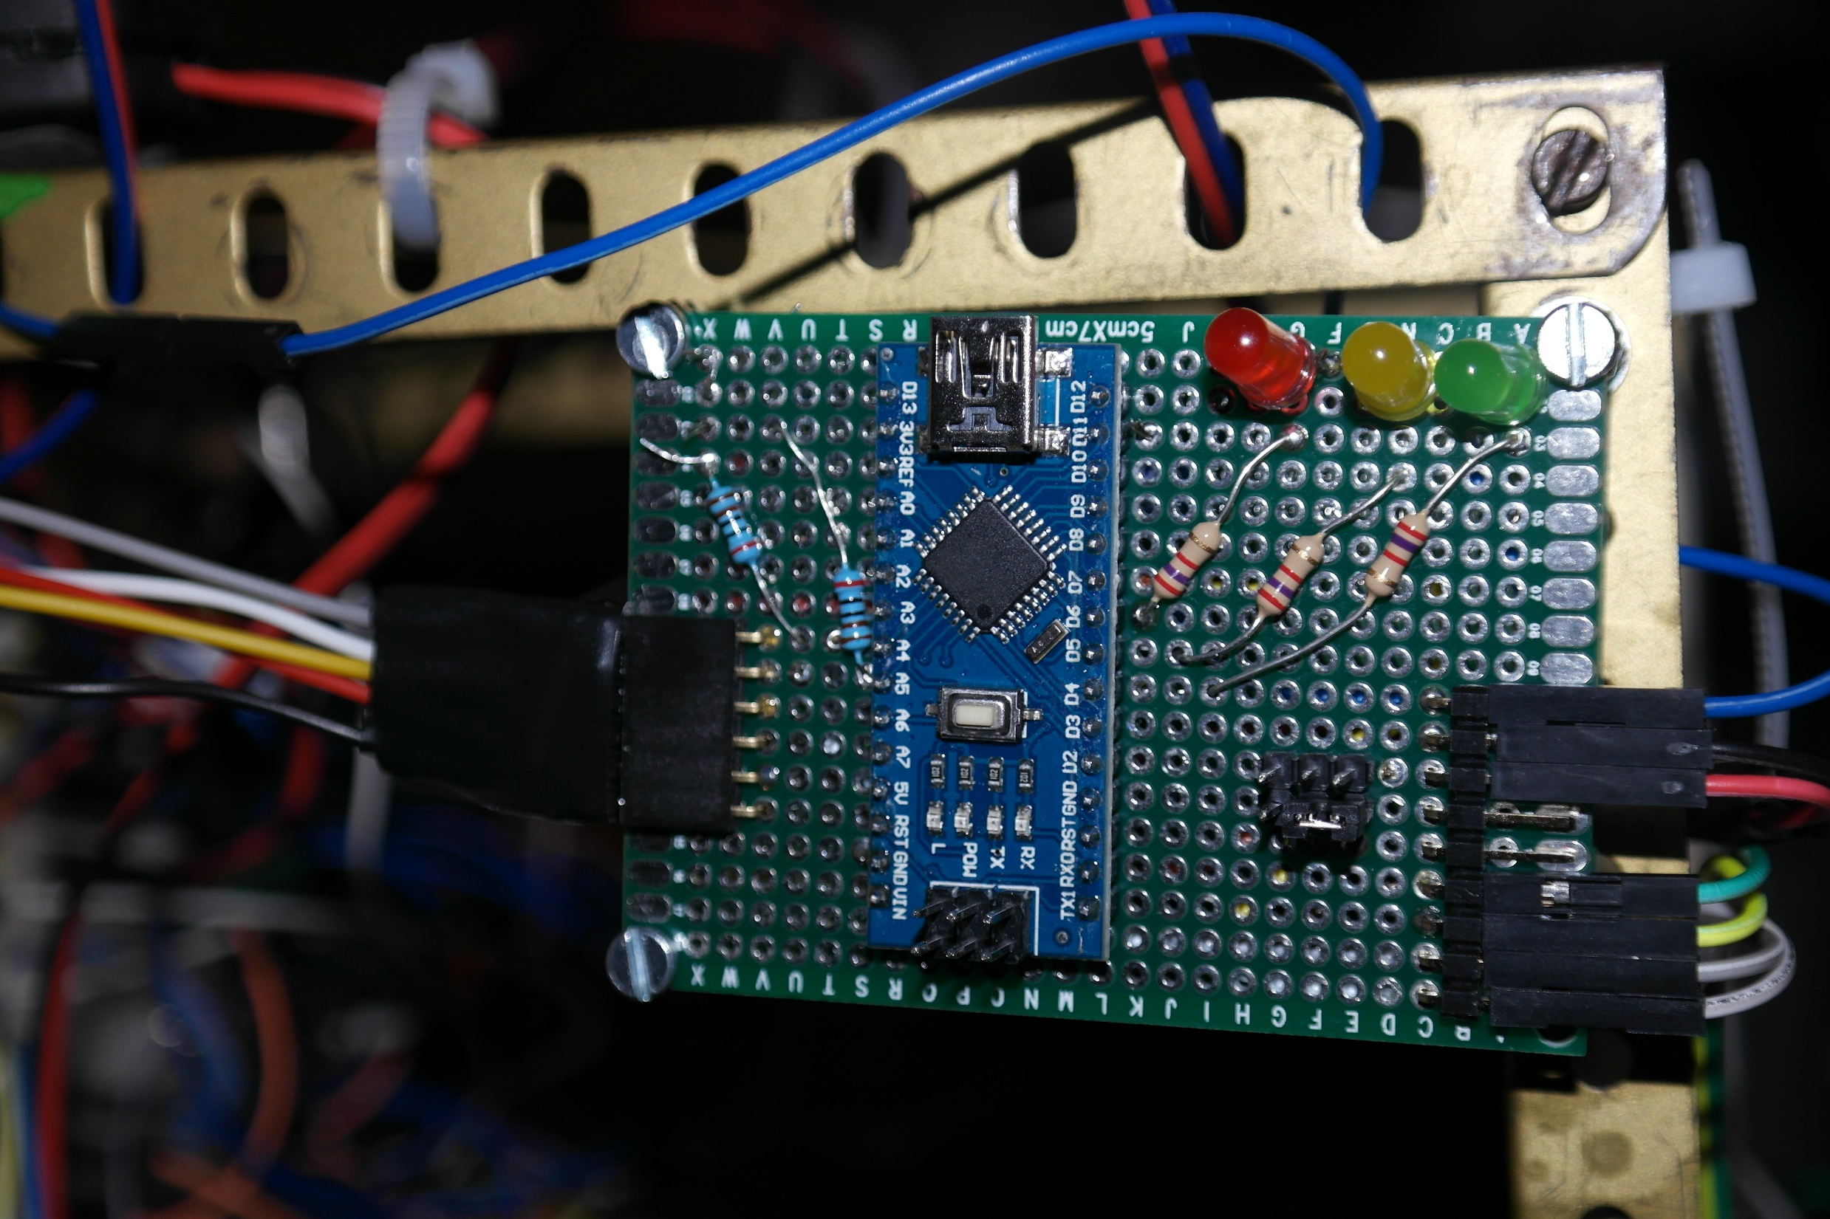
2 x I2C pull-up resistors
3 x LED resistors
Status LEDs
SDA
GND
SCL
GND
BNO Interrupt
Configuration PIN
+5 V
Nano Pin 12
Nano Pin 11
GND
Inertial Motion Subsystem
Instrutable
BNO055 connection
SDA
+5 V
Robot connection
Arduino Nano
SCL

Slide 15
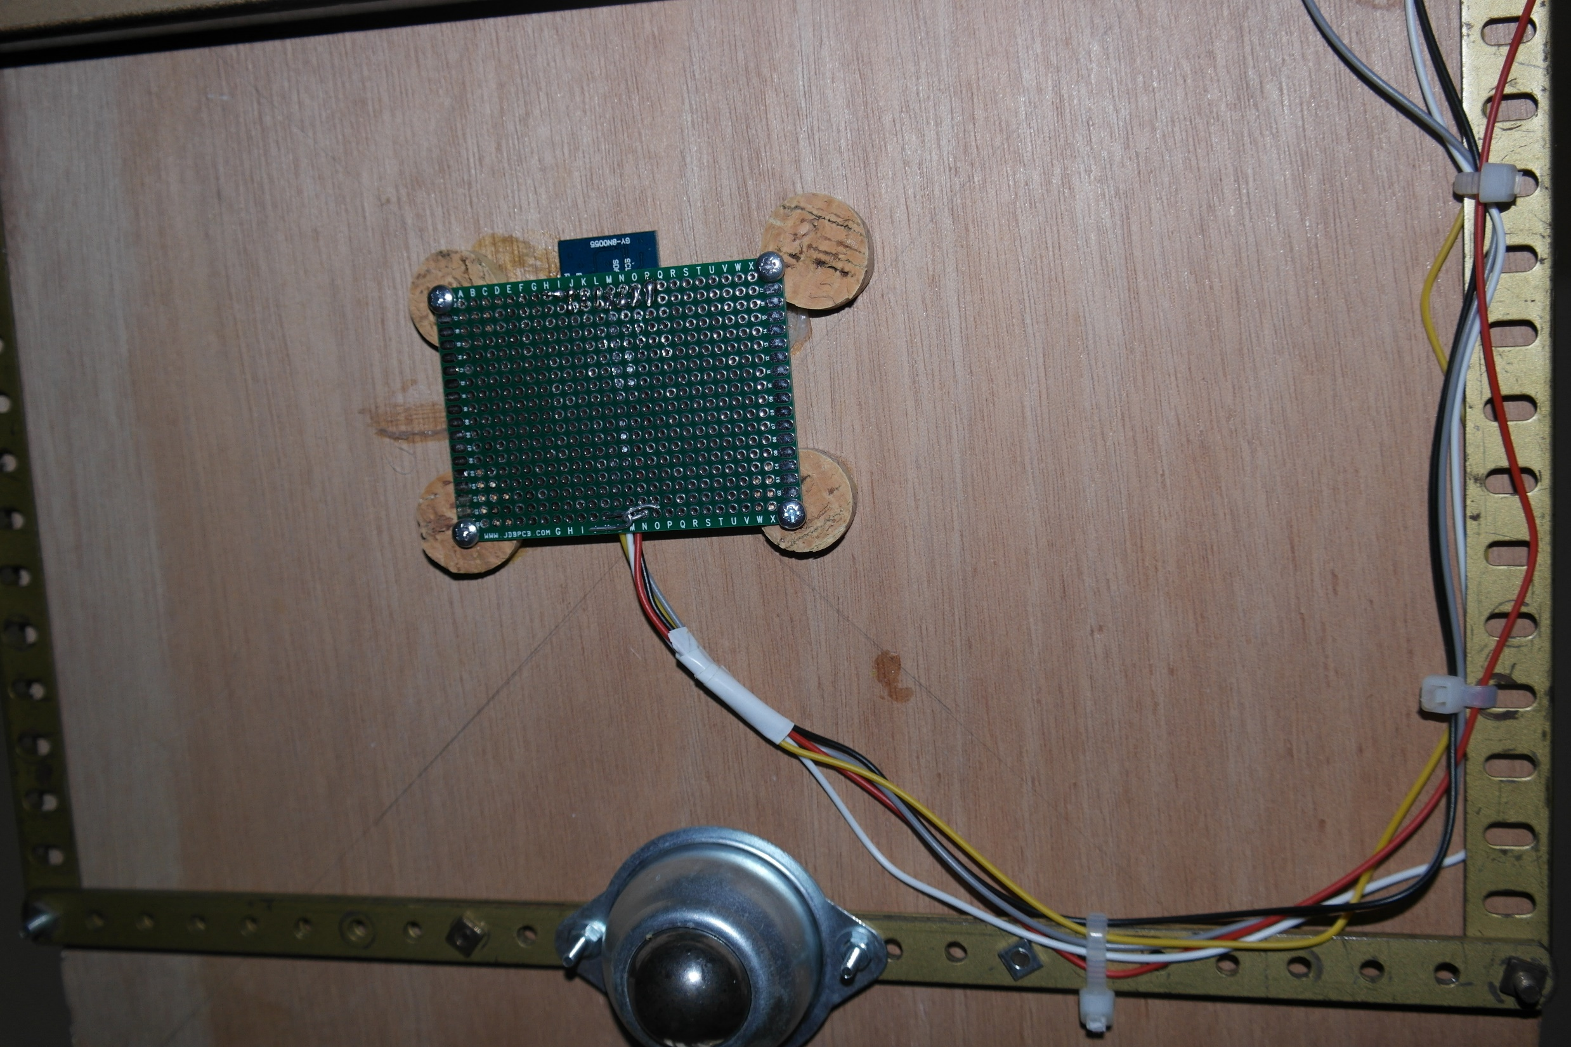
BNO055
Ground
BNO Interrupt
SCL
+5 volts
SDA
Free front wheel

Slide 16
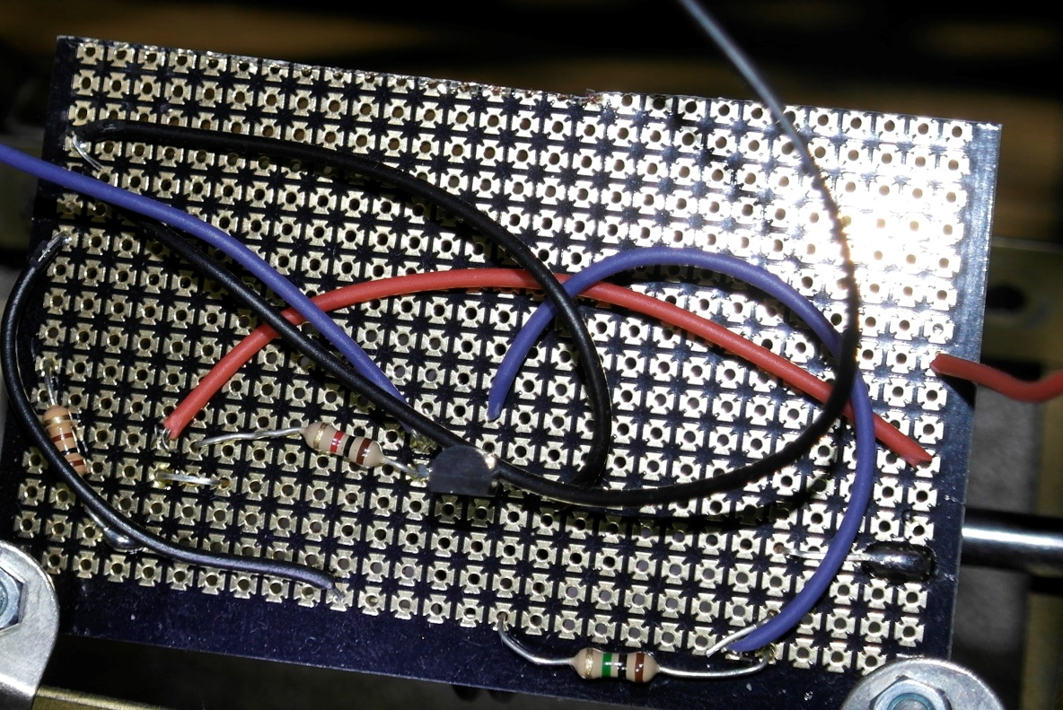
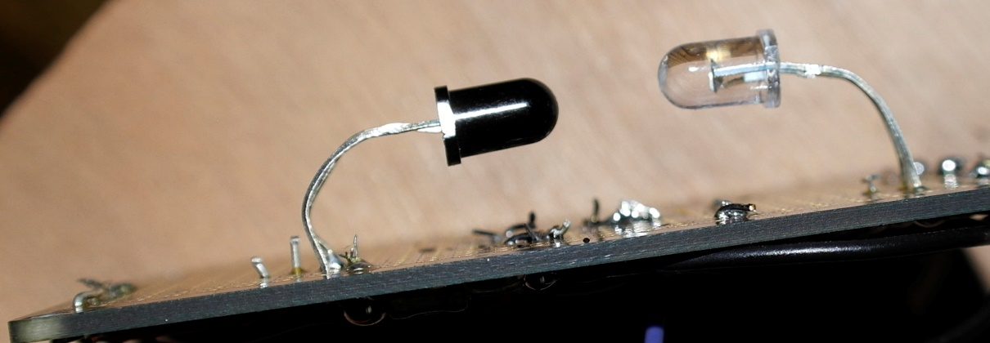
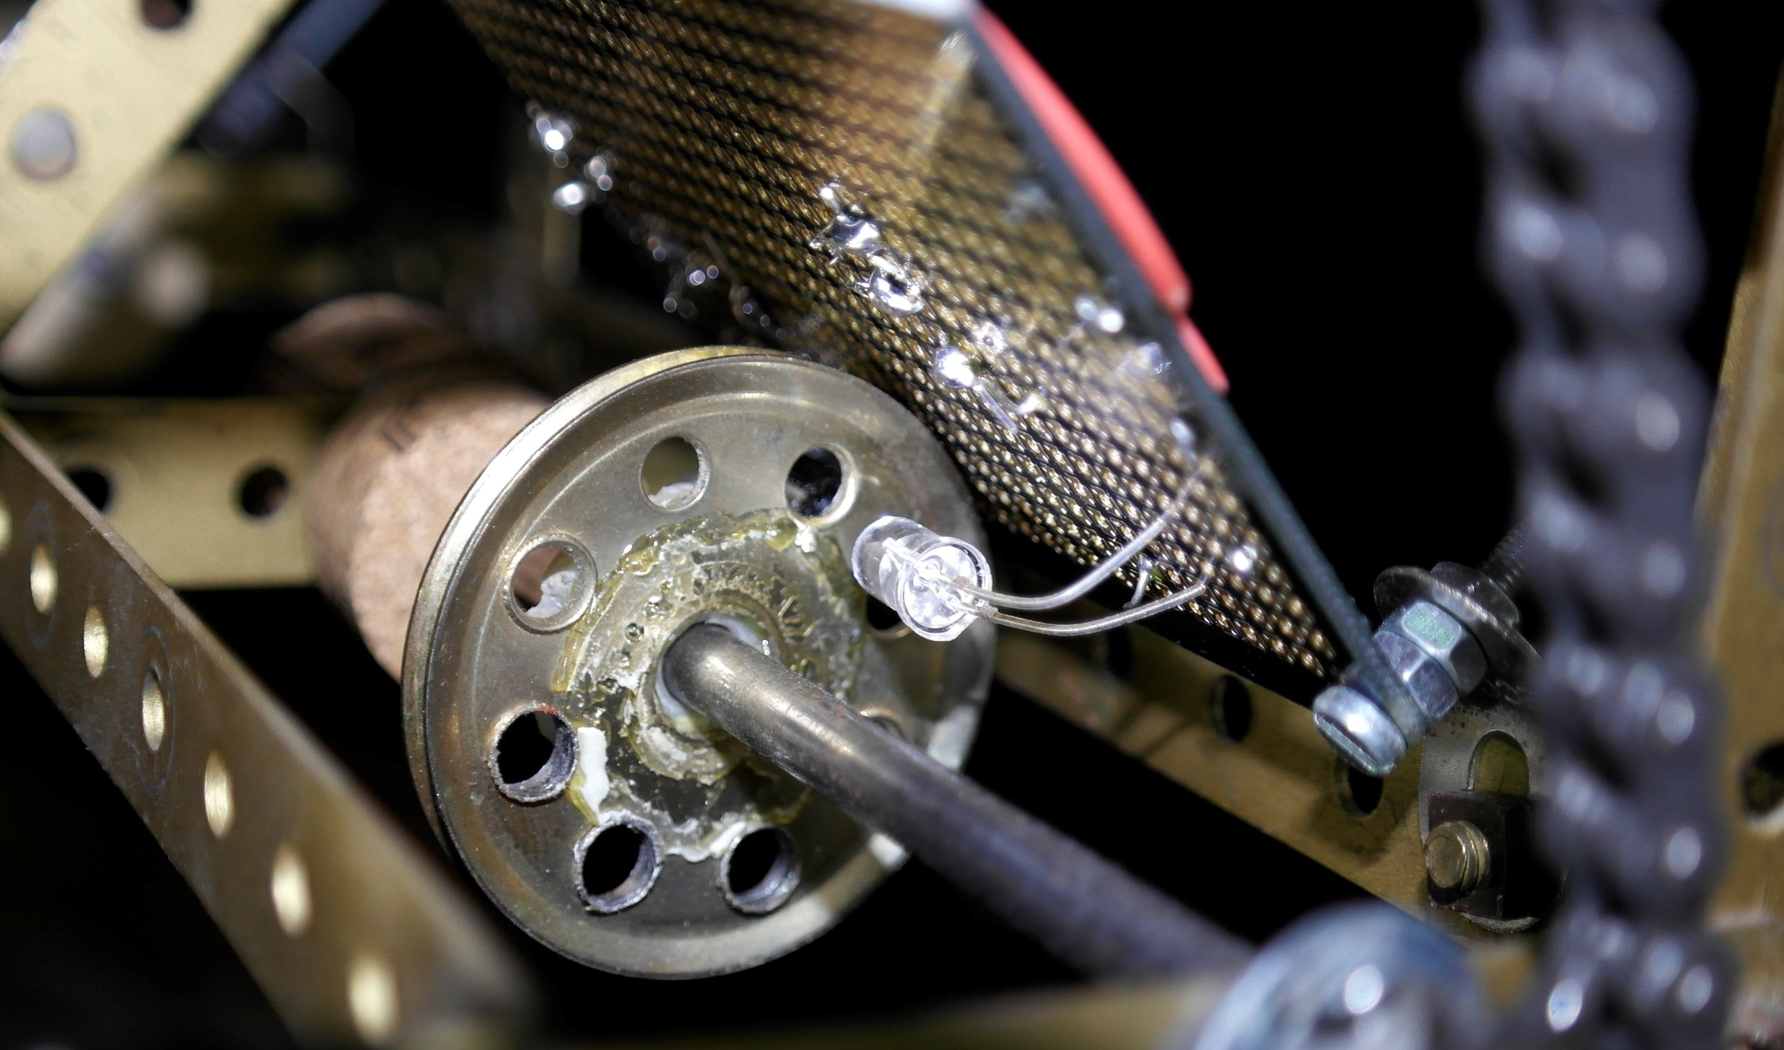
Wheel Encoder instructable

Slide 17
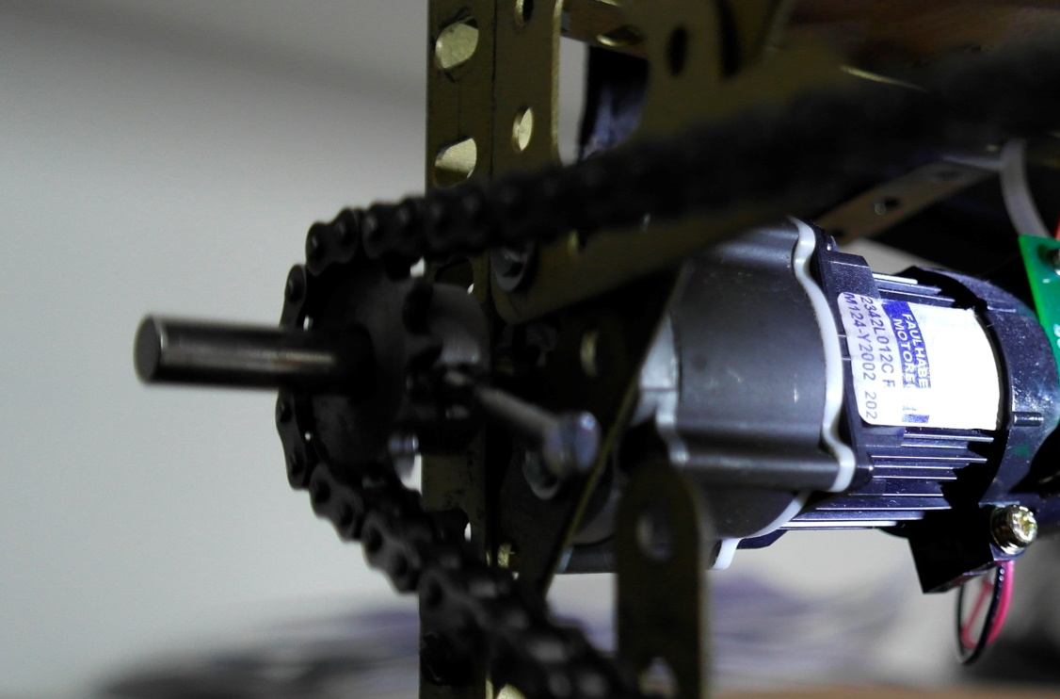
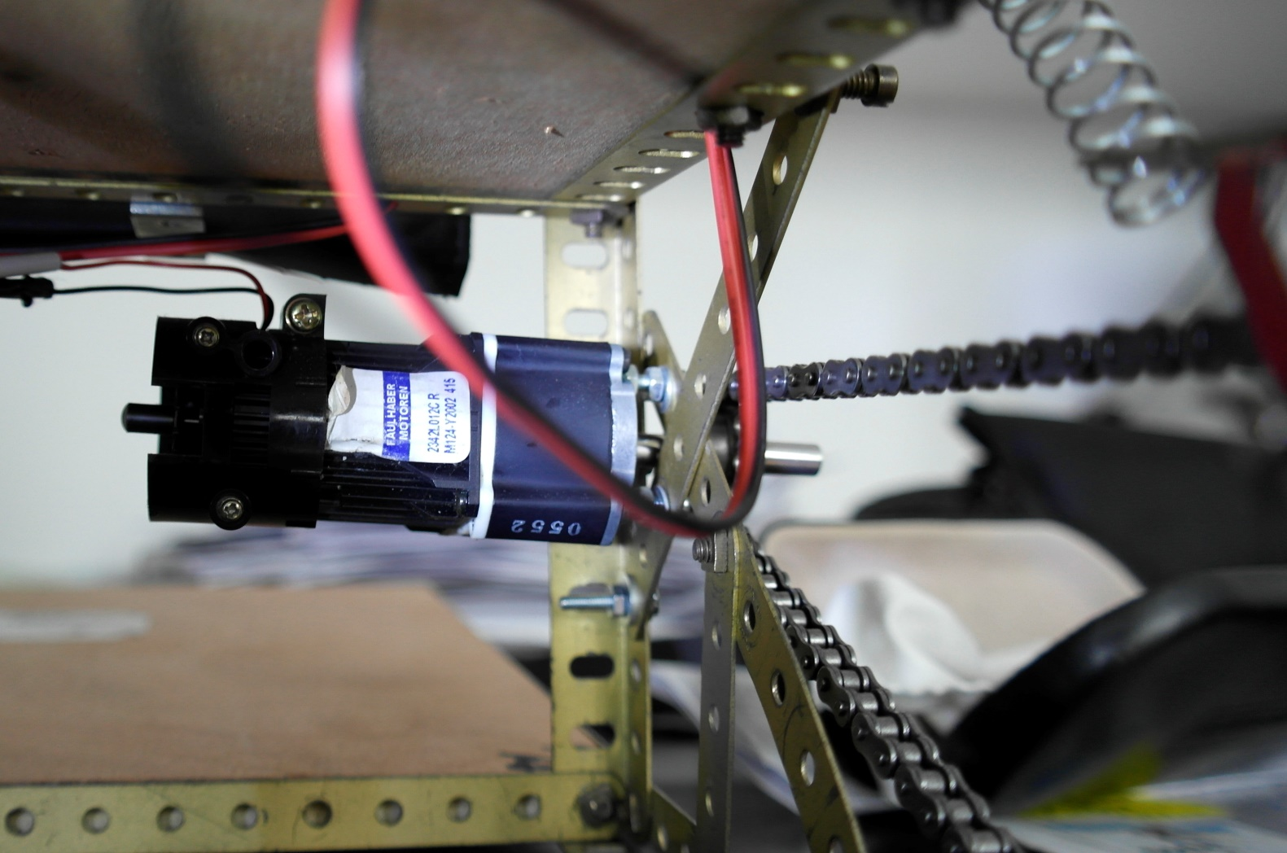
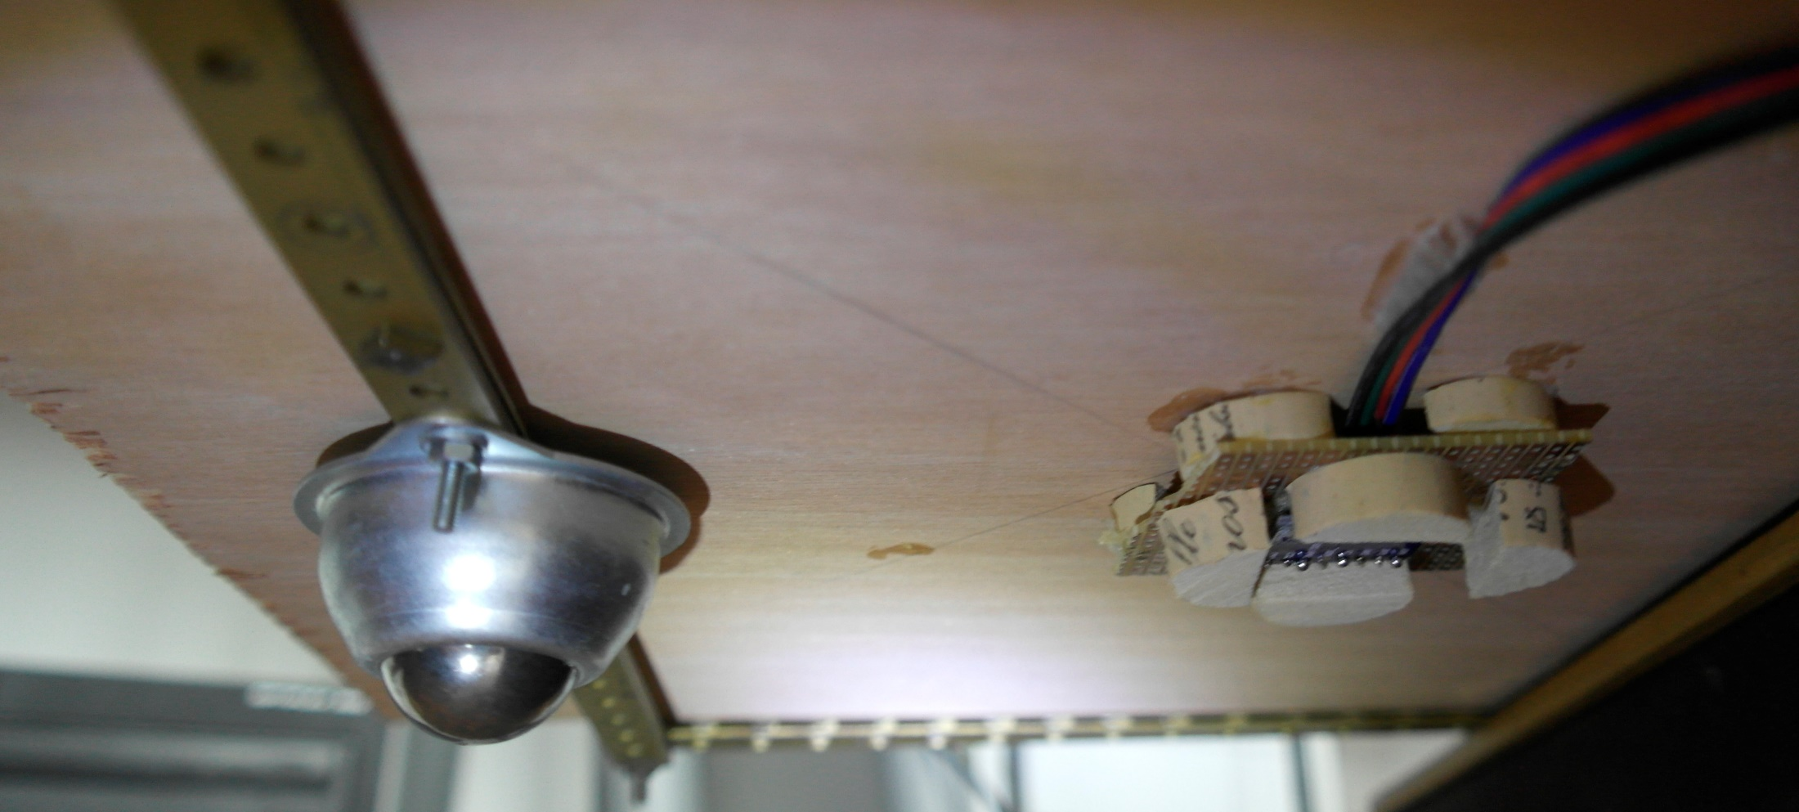
Left motor pinion
Left motor
Right motor
Right transmission chain
Front wheel
Magnetometer & Gyroscope

Slide 18
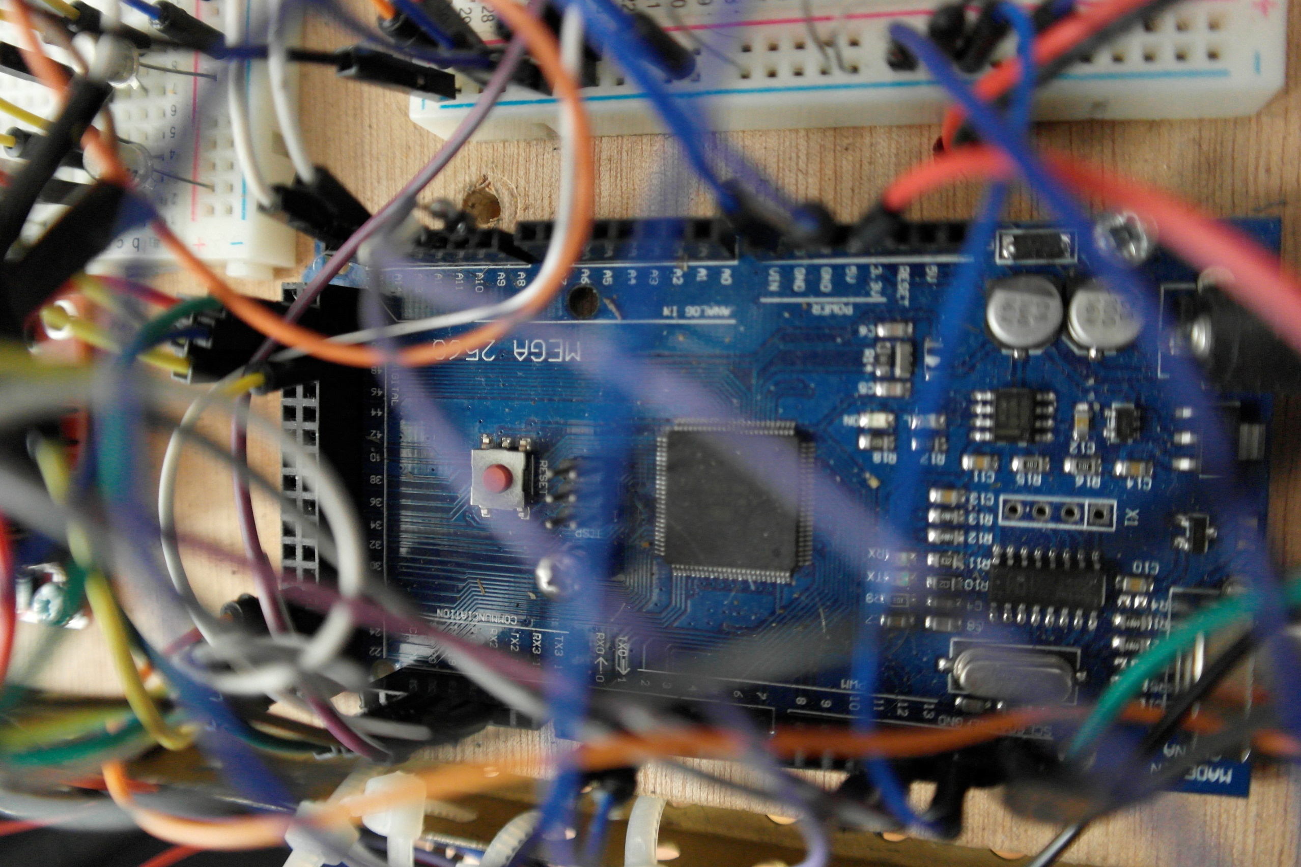
Software
ApeRobot documentation

Slide 19
IR sensors

Slide 20
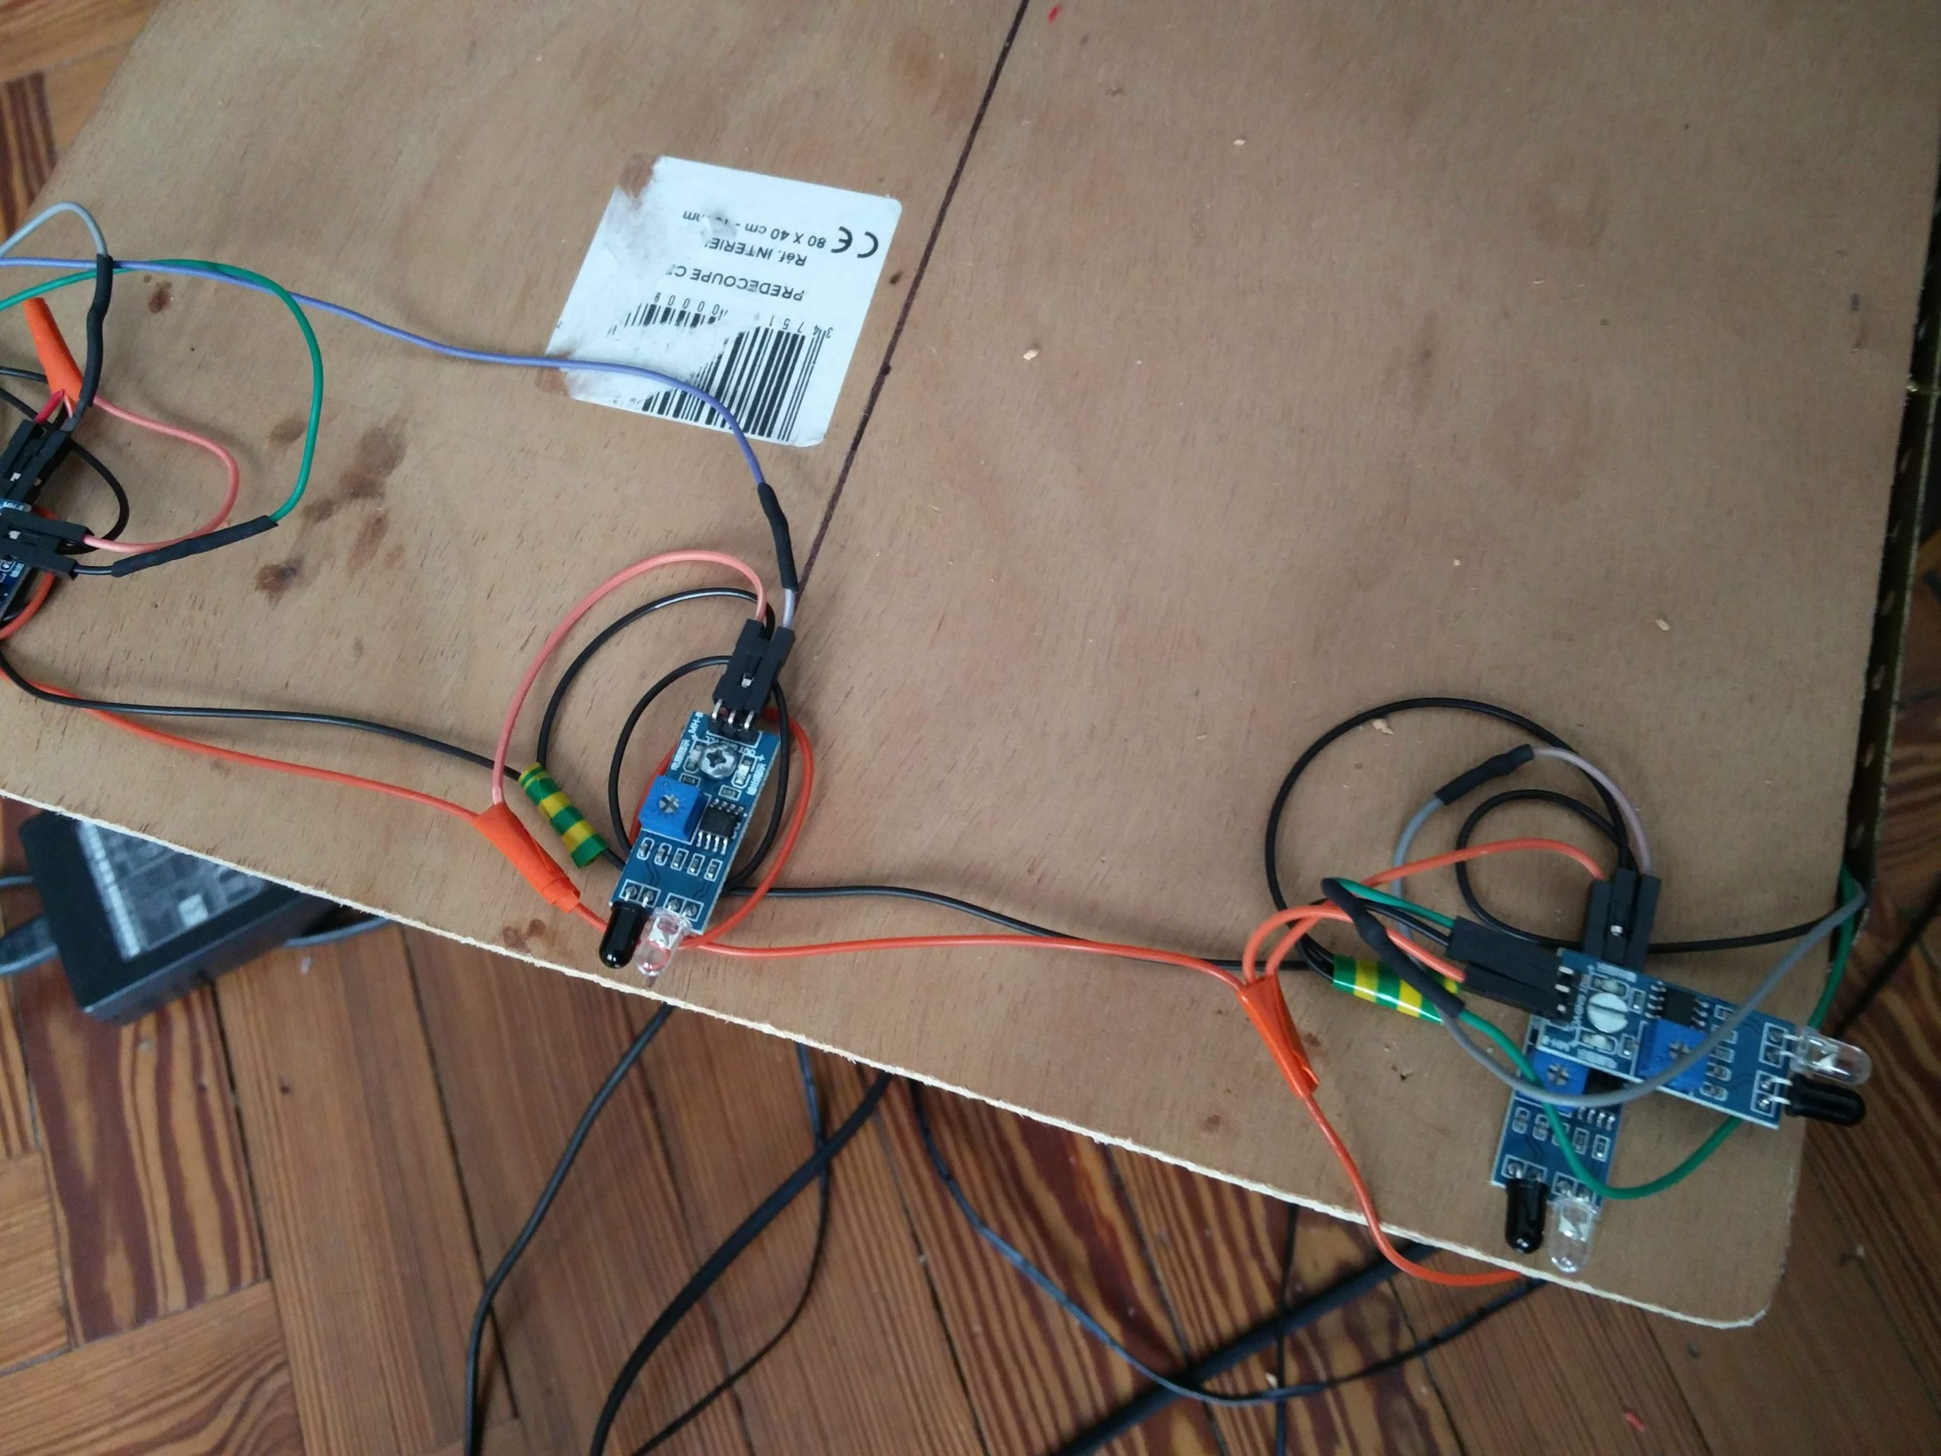
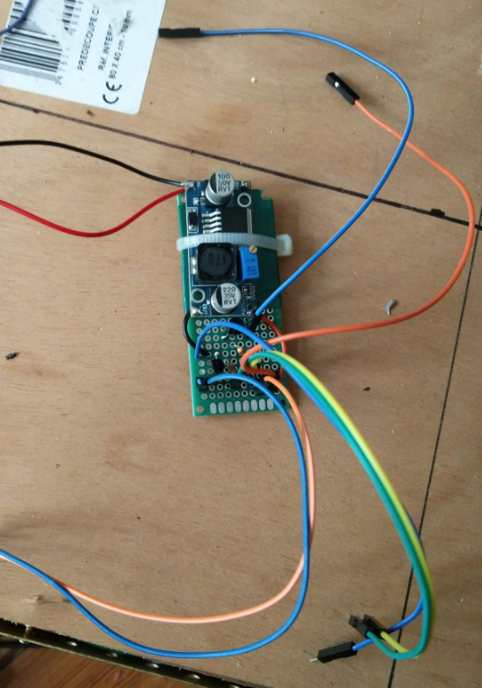

Slide 21
IR Sensors Bit Mapping
2
Back Front
1
3
0
5
4

Slide 22
The software

Slide 23
Software Architecture
Windows / Java / MySql
Virtual/Robot Interface
Instructions and information
exchanges
Robot simulator
Arduino / C++
ESP8266 / C
Physical layer
Monitor & Control Hardware Components
Windows / Octave
Main Layer
Localize Robot
Compute trajectory
Control Robot
Particles filter
Files transfer
Windows / Miniconda / Python
Deep learning layer
Tensorflow
Object exchanges
WIFI UDP / Serial Gateway
I2C bus

Slide 24
Software Implementation
Octave and Java running on Windows 10 64 bits platform
Tensforflow / python running on miniconda
Robot physical layer software running on Atmega arduino Platform
Inertial movement subsystem running on Arduino Nano
Serial/WIFI gateway running on ESP8266

Slide 25
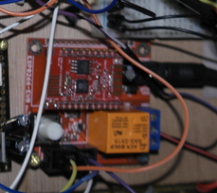
The WIFI UDP/Serial Gateway
Based on ESP8266 micro-controler
Developped with Arduino IDE
Act as a gateway
From UDP to Serial
From Serial to UDP
Route any ascii trame up to 30 bytes
Maximim two consecutive binary bytes inside the trame
Code available on GitHub
Gateway Instructable

Slide 26
IMU Sub-system architecture
BNO055 calibration data
Arduino Mega
Arduino Nano
Registers
Registers
Request
GPIO
BNO055
sensor
Interrupt
GPIO
Ready
GPIO
Sda
Slave
Scl
Sda
Master
Scl
Sda
Slave
Scl
I2C Bus
Response
Command
IMU Instructable

Slide 27
Geometrical point of view

Slide 28
Axis and Heading
Y axis
Servo-motor align 90°
Servo-motor align 180°
Heading
y
Back
Front
North Orientation
Servo-motor align 0°
x
X axis
North

Slide 29
Headings
Y axis
South
RelativeHeading
(used to monitor moves – IMU mode)
H
A
BNOPermanentShiftHeading
(used to eventualy adjust with physical bias)
BNO055
+
Location Heading
(used to locate the
Robot - NDOF & IMU mode)
+
C
North Heading
Compas mode
X axis
NorthXAverageShift
(average of north local values
– scan location)
North
North local values

Slide 30
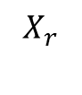
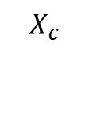
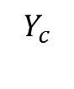
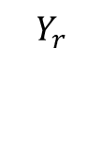
Rotations
T
Y axis
H
Back
A
Front
Q
$$Y_{r}$$
P'
P
$$Y_{c}$$
C
P: initial robot position
Q: robot position after rotation
C: rotation center
H: initial heading
T: target position
A: rotation to do to reach the target
$$X_{c}$$
$$X_{r}$$
X axis
S: distance between C and P

Slide 31
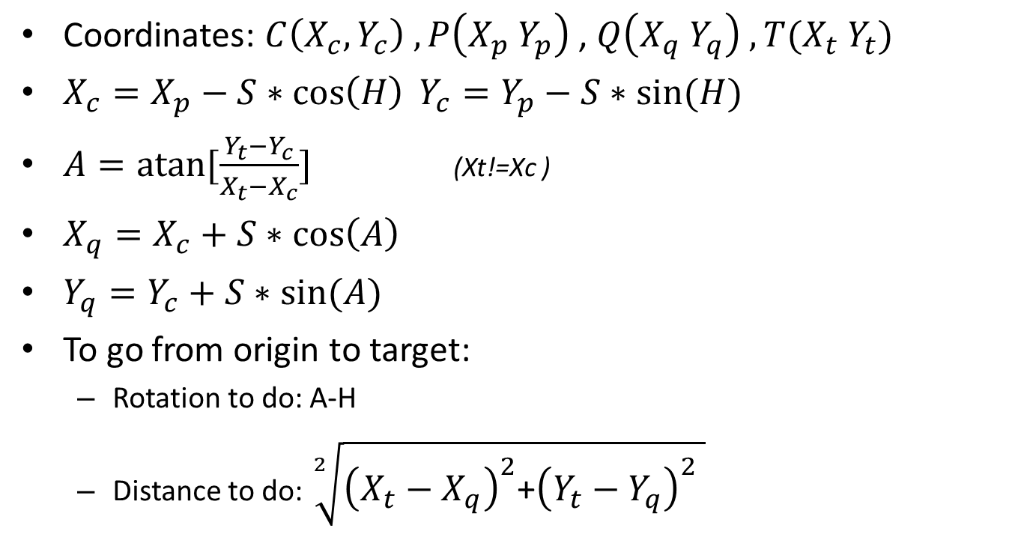
Move: computation
Coordinates: $C\left(X_{c},Y_{c}\right) , P\left(X_{p} Y_{p}\right)$ , $Q\left(X_{q} Y_{q}\right) ,T(X_{t} Y_{t})$
$X_{c}=X_{p}−S∗\cos\left(H\right) Y_{c}=Y_{p}−S∗sin⁡(H)$
$A=atan⁡[\frac{Y_{t}−Y_{c}}{X_{t}−X_{c}}]$ (Xt!=Xc )
$X_{q}=X_{c}+S∗\cos\left(A\right)$
$Y_{q}=Y_{c}+S∗sin⁡(A)$
To go from origin to target:
Rotation to do: A-H
Distance to do:$\sqrt[2]{{\left(X_{t}−X_{q}\right)}^{2}\text{+}{\left(Y_{t}−Y_{q}\right)}^{2} }$

Slide 32
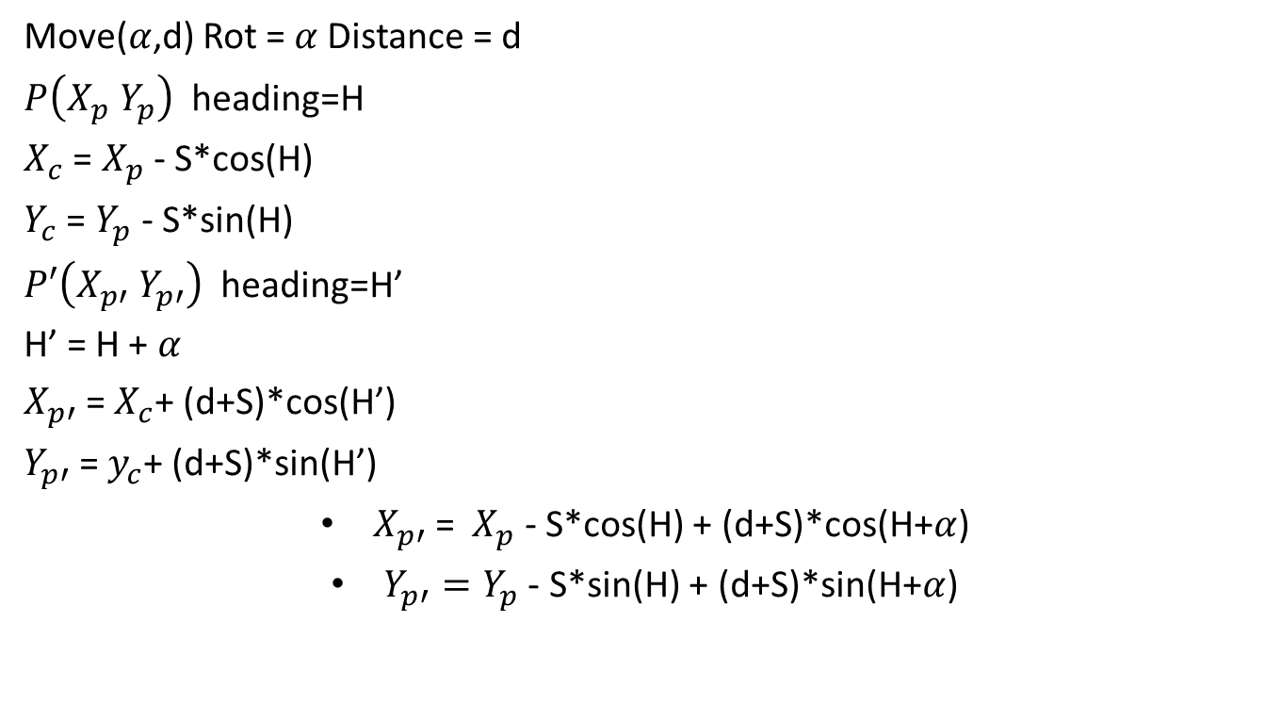
Move
Move($α$,d) Rot = $α$Distance = d
$P\left(X_{p} Y_{p}\right)$ heading=H
$X_{c}$ = $X_{p}$ - S*cos(H)
$Y_{c}$ = $Y_{p}$ - S*sin(H)
$P′\left(X_{p′} Y_{p′}\right)$ heading=H’
H’ = H + $α$
$X_{p′}$= $X_{c}$+ (d+S)*cos(H’)
$Y_{p′}$= $y_{c}$+ (d+S)*sin(H’)
$X_{p′}$= ${ X}_{p}$ - S*cos(H) + (d+S)*cos(H+$α$)
$Y_{p′}=Y_{p}$ - S*sin(H) + (d+S)*sin(H+$α$)

Slide 33
Move PID control
For left and right wheels
Define wheel speed target
Compute wheel speed based on encoders
Speed target
PID
Motor
PWM
Actual wheel speed

Slide 34
Echo localization

Slide 35
Notes ping echo
1
Y
e1
3
4
180°
h
a1
e4
a2
e3
h
0°
e2
2
X

Slide 36
Notes ping echo
1
Y
e1
3
4
a1
a2
h
0°
e4
e3
180°
e2
2
X

Slide 37
Notes ping echo
1
Y
e1
3
4
0°
h
a2
e4
a1
180°
e3
e2
2
X

Slide 38
Notes ping echo
1
Y
e1
3
4
180°
h
e4
a2
e3
0°
a1
e2
2
X

Slide 39
Ping Echo
Si 90 < h <=180
a2=270-h a1=180-h
e1=PF(a1) e2= PB(a1)
e3=PB(a2) a4=PF(a2)
Si 0 <= h <=90
a2=90-h a1=180-h
e1=PF(a1) e2= PB(a1)
e3=PF(a2) a4=PB(a2)
Si 180 < h <=270
a1=360-h a2=270-h
e1=PB(a1) e2= PF(a1)
e3=PB(a2) a4=PF(a2)
Si 270 < h <360
a2=450-h a1=360-h
e1=PB(a1) e2= PF(a1)
e3=PF(a2) a4=PB(a2)

Slide 40
Artificial intelligence

Slide 41
AI usage
Machine learning (logistic regression) used to localize the robot based on echoes
Particles filters used to control the motion of the robot

Slide 42
Move Across Narrow Path
Typically move across a door

Slide 43
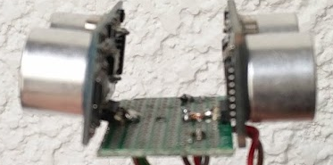
Step 1
North
Path length
North orientation
Path width
passDistance
The sonar moves & pings toward the pass
Notes:
Maximum move length is defined by passDistance

Slide 44
Step 1
Path length
Path width
The sonar still detects the pass edges
Notes:
Maximum move length is defined by passDistance

Slide 45
Step 2
Pass start
The sonar no longer detects the pass edges

Slide 46
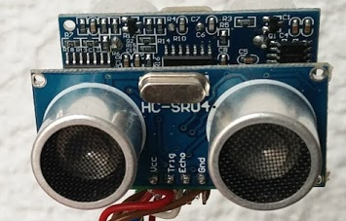
Step 3
Sonar orientation 90° VS move

Slide 47
Step 4
Pass entry
The sonar detects the pass width

Slide 48
Step 5
Path center
The sonar monitors the pass width

Slide 49
Step 6
Pass exit
The sonar detects the width change

Slide 50
End
Sonar orientation 0° VS move

Slide 51
MoveAcrossPath parameters
passStartDistance: maximum distance before reaching the start point
northOrientation: go thru orientation
EchoToGet: minimum front echo distance over that robot is beyond start point
Width: pass width from sonar point of vue (side oriented)
startToEntryDistance: maximum distance between the start and entry point
reqMove: distance to move after reaching the pass exit
Lenght: distance between pass entry and pass exit (sonar beam point of view)

Slide 52
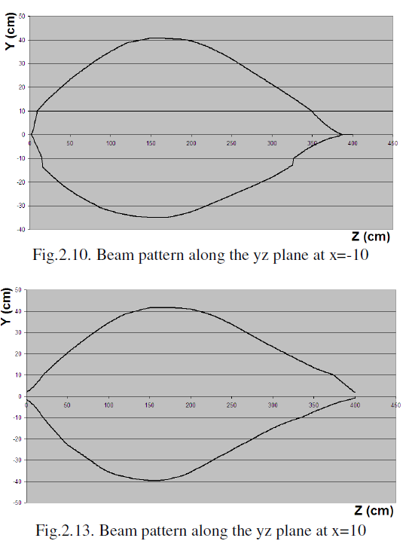
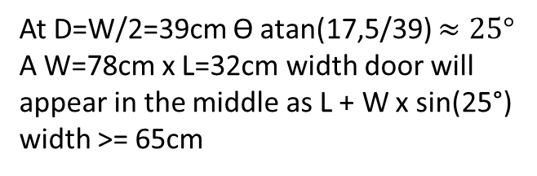
Sonar Beam
At D=W/2=39cm ϴ atan(17,5/39) $≈25°$
A W=78cm x L=32cm width door will appear in the middle as L + W x sin(25°) width >= 65cm
Distance | Width | Angle
25 | 14 | 30°
50 | 21 | 23°
100 | 35 | 19°
150 | 40 | 16°
200 | 40 | 11°
250 | 32 | 7°
300 | 20 | 4°
350 | 10 | 2°

Slide 53
Move accross path Code
passMonitorStepID: 0xYZ
Y bit (interrupt(7),request(6),, skipStep(4))

Slide 54
Test cases
Step | Case | Sub-case | Error | Action
1 | Move not started | Echo already over echoToGet | no | Skip step 1
1
1 | Move problem | wheelSpeedIssue | yes | Report move
1 | Move completed |  | yes | Report move
1 | Move echo interrupted |  | no | Got to Next step
2 | Move problem | wheelSpeedIssue | yes | Report move
2 | Move completed |  | yes | Report move
2 | Move echo interrupted |  | no | Got to Next step

Slide 55
The Java main classes
Initialize
Create java object
Launch java batch
robot.SetTraceFileOn(true)
Echo location
Servo-motor
RobotAlignServo(degre)
Ping
Scan360
PingEchoFrontBack
Get result
GetScanAngle(x)
GetScanFrontDist(x)
GetScanBackDist(x)
Move
Move(rotation,distance)
NorthAlign(NO)
Robot Location
GetNorthOrientation() arduino data
GetHardPosX() arduino data
GetHardPosY() arduino data
GetHardAngle() arduino data
SetPosX(value) java data
SetPosY(value) java data
SetHeading(value) java data
ValidHardPosition() update java data with arduino data
UpdateHardRobotLocation() update arduino data with java data

Slide 56
The Octave Main Functions
Localization
Cartography
QueryCartoAvailability(carto1,xIn,yIn,heading,debugOn)
Check if a location is possible taking into account physical characteristics
Echo analyze
EchoLocalizeRobotWithRotation(robot,nbLocPossibility,x,heading)
IA analyze last echo scan to determine the x most likely robot position according to the heading
TestLocationEchoConsistancy(robot,carto,posX,posY,heading)
Analyse 4 x 90° echo to compute location probality taking into account specific cartography points
Particles
CreateLocatedParticles(carto,posX,posY,heading,locProb,particlesNumber,plotOn)
Create particles taking into account current location probability and cartography
MoveParticles(rotationToDo,lenToDo,plotOn,particles)
Moves particles with noise
DetermineRobotLocationWithParticlesGaussian(newX,newY,prob,plotOn,particles)
Find the most likely particles positions according to the new mesurments
ResampleParticles(plotOn,particles)
Resample the particles taking into account the probabilty

Slide 57
The Octave Main Functions
Trajectory
InitCurrentLocation(carto,robot)
Manualy set current location with probability
ComputeTargetLocation(carto,robot)
Manualy set target location
ComputeNextStepToTarget(carto,X,Y,heading,targetX,targetY,plotOn)
CheckStraightMovePossibility()
Check if it is possible to go straight forward
AStarSearch()
Compute a path to the target
return the next step to do
ComputeMoveToDo(robot.GetHardPosX,robot.GetHardPosY,robot.GetHardAngle,nextX,nextY)
Return rotation and distance to do to reach the next step
Global
WaitForRobot(robot,WaitForKind)
Wait for action defined by WaitForKind to be completed and provide return code

Slide 58
Maintenance
Resistors’s values mesured out off power supply:
Power servo motor 5v: 560 ohms
Power Motors 10v : 1250 ohms
Power Arduino 9 volts: 520 ohms
Power Miscellaneous 5v: 1150 ohms

Slide 59
Application architecture
Action | Mode | Octave | Java | C Arduino
Ping | Simu | Simulate echo | NA | NA
Ping | Norm | Request | Transfers request and response | Drive servo motor & sensors & IMU
Move | Simu | Request to Java | Simulate hardware and return values (optional noise and errors) | NA
Move | Norm | Request to Java | Transfers request and return code | Drive motors & wheels encoders & IMU
Rotate | Simu | Request to Java | Simulate hardware and return values (optional noise and errors) | NA
Rotate | Simu | Request to Java | Simulate hardware and return values (optional noise and errors) | Drive motors & IMU
Scan | Simu | NA | NA | NA
Scan | Norm | Request | Transfers request and response | Drive servo motor and sensors & IMU
Horn | Simu | NA | NA | NA
Horn | Norm | Request | Transfers request | Drive speaker

Slide 60

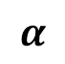
North orientation bias
Y
Robot
β
$$α$$
X
β: bias between robot theoretical X orientation and actual one

Slide 61
Localization: Step 1
Particles are randomly created all over the graph, oriented following a ramdom gaussian distribution around X
Robot X oriented using compass
Y
Robot
Robot
$$α$$
X
$α$: shift between North and X axis (X axis corresponding with scan learning)

Slide 62
Localization: Step 2
360° Scan is done
Deep learning used to compute more likely positions are applied to particles filter
The robot position is estimated to be at the highest particles probability
Y
P1
Robot
$$α$$
X
$α$: shift between North and X axis (X axis corresponding with scan learning)

Slide 63
Localization: Step 3
Robot move in a direction
Move particle according (P1 move to P’1)
Robot X oriented with compass
Y
P1
Robot
P’1
Robot
Robot
$$α$$
X

Slide 64
Localization: Step 4
360° Scan is done
Deep learning used to compute more likely positions are applied to particles filter
The robot position P2 is estimated to be at the highest particles probability
If P’1 and P2 close enough robot localized else loop
Y
P’1
P2
Robot
$$α$$
X

Slide 65
Automate: les actions
(NorthAlign,retcode)
(Move ,retcode)
(Rotate,retcode)
(Scan360,retcode)
(pingFB,retcode)

Slide 66
Automaton : localization
(Loc,NLo,Mov)
(Move,-1)
(Rotate,0)
(Move,11)
(Move,0)
(loc,Det,NOr)
(Rotate,-1)
(Scan,0)
(Det,0)
(Loc,NLo,Rest)
(NOr,0)
(Loc,NLo,NOr)
(Lost,NLo,Scan)
(Loc,NLo,Scan)
(NOr,11)
(Det,1)
(Scan,1)
(Lock,NLo,rest)
(Tar,Loc,NOr)
(NOr,-1)

Slide 67
Moving toward the target: Step 1
Create localy spreaded particles according the determined position
Location (x,y,heading) normaly distributed around the determinated position
Y
Target
Robot
X

Slide 68
Moving toward the target: Step 2
Compute path and steps
Y
3
4
Target
2
Robot
1
X

Slide 69
Moving toward the target: Step 3
Compute move to the next step: (rotation, distance)
Y
3
4
Target
2
Robot
1
X

Slide 70
Moving toward the target: Step 4
Move to the next step robot and particles (rotation, distance)
Y
3
4
Target
2
Robot
1
X

Slide 71
Moving toward the target: Step 5
Move to the next step robot and particles (rotation, distance)
Y
3
4
Target
2
Robot
1
X

Slide 72
Moving toward the target: Step 6
Scan + deep learning to determine new position
If 1 and P2 close enough robot loop toward target else enter localization loop
Y
3
4
Target
2
Robot
P2
1
X

Slide 73
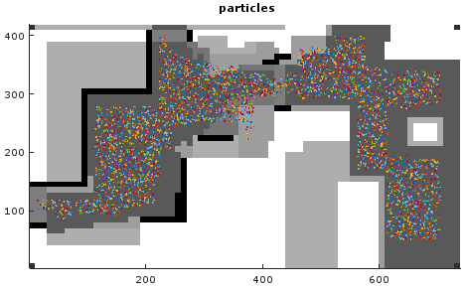
X

Slide 74
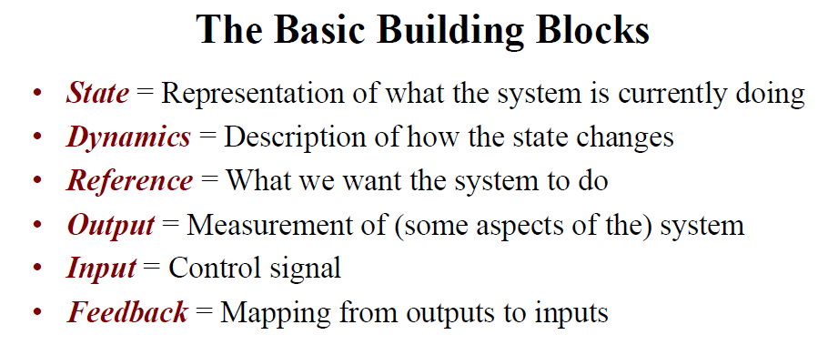
R
+
U
X
Y
-

Slide 75
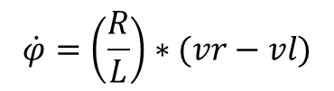
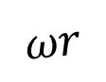
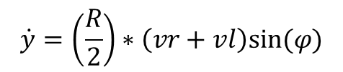
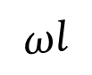
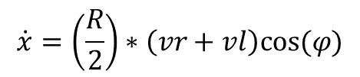
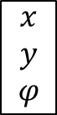
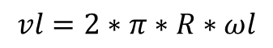
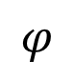
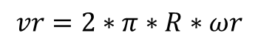
Dynamics
Y
Left Wheel
Ultrasounds
Gyroscope
Accelerometer
$$ωl$$
C2
$$φ$$
L
C0
C1
X
$$\begin{matrix}x \\ y \\ φ\end{matrix}$$
Pos C0 =
$$ωr$$
$$\dot{x}=\left(\frac{R}{2}\right)∗\left(vr+vl\right)cos⁡(φ)$$
R
$$\dot{y}=\left(\frac{R}{2}\right)∗\left(vr+vl\right)sin(φ)$$
Right Wheel
$$\dot{φ}=\left(\frac{R}{L}\right)∗(vr−vl)$$
$$vr=2∗π∗R∗ωr$$
$$vl=2∗π∗R∗ωl$$

Slide 76

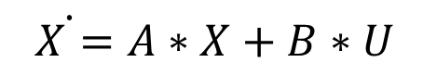
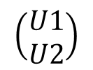
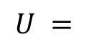

LTI Model
U
$\dot{ X=}A∗X+B∗U$
Y
$$Y=C ∗X$$
$X$: state
Y: output
U: input
$$\left(\begin{aligned}U1 \\ U2\end{aligned}\right)$$
U1=f(PWM Left)
U2=f(PWM Right)
$$U =$$

Slide 77






State Space
$$\left[\begin{aligned}x \\ y \\ φ \\ \\ \dot{\begin{aligned}x \\ \dot{y}\end{aligned}} \\ \dot{φ}\end{aligned}\right.$$
$\dot{ X=}A∗X+B∗U$
($x$, $y$): C0 position
$φ$: robot heading
($\dot{x},\dot{y})$: C0 speed
$\dot{φ}$: robot angular speed
$$Y=C ∗X$$
X=
$$X^{′}=\begin{matrix}x′ \\ y′ \\ \begin{aligned}φ′ \\ x′′ \\ y′′ \\ φ′′\end{aligned}\end{matrix}$$
$$A=\begin{matrix}0 & 0 & 0 & 1 & 0 & 0 \\ 0 & 0 & 0 & 0 & 1 & 0 \\ 0 & 0 & 0 & 0 & 0 & 1 \\ 0 & 0 & 0 & 0 & 0 & 0 \\ 0 & 0 & 0 & 0 & 0 & 0 \\ 0 & 0 & 0 & 0 & 0 & 0\end{matrix}$$

Slide 78






Sensors
Encoders
$ωr$ and $ω$l
Gyroscope
$$\dot{φ}$$
Accelerometer
$$\ddot{\begin{aligned}x′ \\ \ddot{y′}\end{aligned}}$$
IMU
$$φ$$
$$y$$
$y$’
$x$’
$$φ$$
$$x$$

Slide 79

Wheel Encoders
$N=8 ticks a wheel$
$Δtick=tick^{′}−tick$
D=2*$Π∗R∗$($Δtick$/N)

Slide 80
Motors
faulhaber 2342 s 012 cr12v
Vmax 8100 tour/min
Acceleration max 140 10-3 rad/s2

Slide 81



C3
WD: diamètre roues
minRPS
maxRPS
C2
WI
Espace entre
roues
C1:Cercle 1
RB
Rayon
braquage
A vitesse constante
S1=minRPS*π*WD
S3=maxRPS*π*WD
S2=(S1+S3)/2
S1
$$φ$$
S2
S3
Durée un tour par le robot
DtR=P1/S1=P2/S2=P3/S3
Périmètres
P1=2*π*(RB-WI/2)
P2=2*π*RB
P3=2*π*(RB+WI/2)
T0+$∆t$
$$φ(∆t)=\left(\frac{∆t}{DtR}\right)∗2∗π$$
T0
(2*$π∗(RB−\frac{WI}{2}))/(minRPS∗π∗WD)=(2∗π∗(RB+\frac{WI}{2}))/(maxRPS∗π∗WD)$
$$(RB−\frac{WI}{2}))/(minRPS∗π∗WD)= (RB+\frac{WI}{2}))/(maxRPS∗π∗WD)$$

Slide 82


$$(RB−\frac{WI}{2}))/(minRPS∗π∗WD)= (RB+\frac{WI}{2}))/(maxRPS∗π∗WD)$$
$$(RB−\frac{WI}{2}))/(minRPS)= (RB+\frac{WI}{2}))/(maxRPS)$$
$$(RB−\frac{WI}{2}))∗(maxRPS)= (RB+\frac{WI}{2}))∗(minRPS)$$
$RB∗(maxRPS−minRPS)$ =(WI/2)*($minRPS$+ $maxRPS$)
$RB$= (WI/2)*($minRPS$+ $maxRPS$)/ $(maxRPS−minRPS)$

Slide 83
Odométrie
From calculation point of vue: compassHeading (used for localization)
relativeHeading (used to control rotations)
absoluteHeading and position (used to control moves)
compute for each robot wheels the absolute heading and localization (with a scale factor)
compute the relative heading during rotation of the robot

Slide 84
BNO Modes
3 different running modes:
NDOF (combine gyroscope, accelerometer and Compas) when the robot is idle,
IMU (combine gyroscope, accelerometer) when the robot is moving
Compass during the localization phase

Slide 85
Odométrie location
AtMega => BNO subsystem
When moving regurarly send
requestCompute (delta-leftHoles,delta-rightHoles)
BNO compute C0 location based on locationHeading
Compute C1 location based on [C0,C1,locationHeadin],wheels diameter and encoder holes

